Slide 1
Technical Support (420-1N6-AB) Operating System Installation MS Windows
Fall 2020

Slide 2
Outline
Installing MS Windows
OS Settings while Installation
After OS Installation
User Profiles
Windows Registry
OS Maintenance

Slide 3
Installing MS Windows

Slide 4
Installation Sources
DVD
USB
Network Share
Windows Deployment Services

Slide 5
Network Share
Boot the client computer into the Windows Preinstallation Environment (Windows PE) which is a minimally features OS that allows you to access diagnostic and maintenance tools as well as access network drives.
Once you connect to the network share that hosts the Windows installation files, you can start the installation normally.
Generally slower than installation from DVD-ROM or USB.

Slide 6
Windows Deployment Services (WDS)
This is a role available for Windows Server 2008 which allows for automatic deployment of operating system images to computers with PXE-compliant network adapters.
The WDS transmits the operating system to all computers configured to receive it and starts installation.
PXE = Pre-Boot Execution Environment, component of Intel’s WfM specification which allows a workstation to boot from a server.
A PXE-enabled workstation connects its NIC to the LAN via a jumper which keeps the workstation connected to the network even when the power is off. To be considered “compliant”, the PXE must be supported by the NIC and the BIOS.

Slide 7
Installation Types
Standard Installation
Administrator sitting at the machine answers a series of questions.
Suitable for a small number of computers.
Unattended Installation
Uses an installation file called Autounattend.xml which stores the answers.
Windows will check for USB devices with this file in its root directory.
Suitable for large number of computers.
Details: https://docs.microsoft.com/en-us/windows-hardware/manufacture/desktop/automate-windows-setup

Slide 8
OS Settings while Installation

Slide 9
While Installing OS
Why is it important to provide the proper settings during installation? You can always go to settings and change them later.
Providing the correct settings will make sure the computer runs smoothly without interruptions or downtime.
If the installed OS is used to create an image to be deployed on other computers, it will be important that the all the settings are in place and that none are missing.
Otherwise, you will go to each computer with the deployed image and make the settings change.

Slide 10
While OS Installation
Set a system / administrator password.
It is important to set a password for the default (or administrator) account while installation.
A password will insure illegal or unwanted access to the computer will take place.
Having a password will prevent viruses running over the network to access the computer.
The password should not be easy to guess.

Slide 11
After OS Installation

Slide 12
After OS Installation – What is next?
What should be done after finishing an OS installation?
Install \ Update Device Drivers (if needed)
Network cards driver: to be able to connect to the network/internet.
Update computer operational information:
Set the correct Date, Time and time zone.
Provide a proper name for the computer.
Security:
Install security software: Antivirus
Update OS: install patches, service packs.
Setup firewall.
Install required software applications.

Slide 13
Device Manager
Driver: A driver is a software package that enables the OS to communicate with a specific hardware device.
Typically an .exe file installed by an .inf file.
If the device is Plug and Play (PnP), the driver should install automatically by the OS.
Updated drivers or replacement drivers might need to be installed.
If the driver does not install automatically, you need to install it manually.
From manufacturer website or media available with the hardware component.

Slide 14
Managing Devices And Drivers
A Device Manager provides the following functionality:
Identify the drivers that are installed.
Determine whether a piece of hardware and its driver are working.
View devices by type, connection or resources.
Enable, disable and uninstall devices.
Change hardware configuration settings.
Install updated drivers.
Roll back to the previous version of a driver.
Change advanced settings/properties of a device,
Show hidden devices

Slide 15
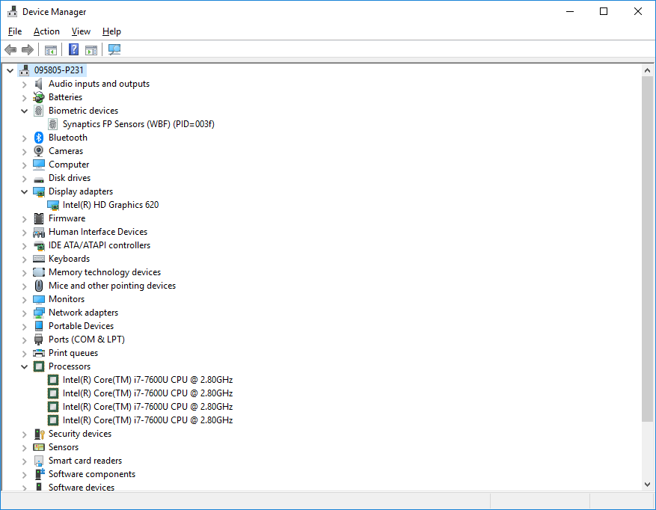
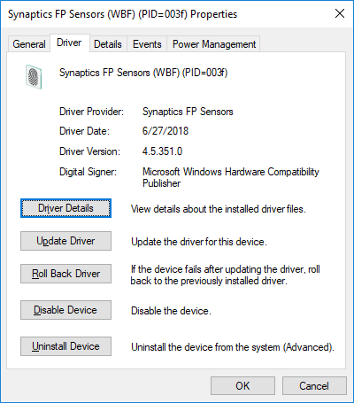
HW Devices Properties – Driver Tab

Slide 16
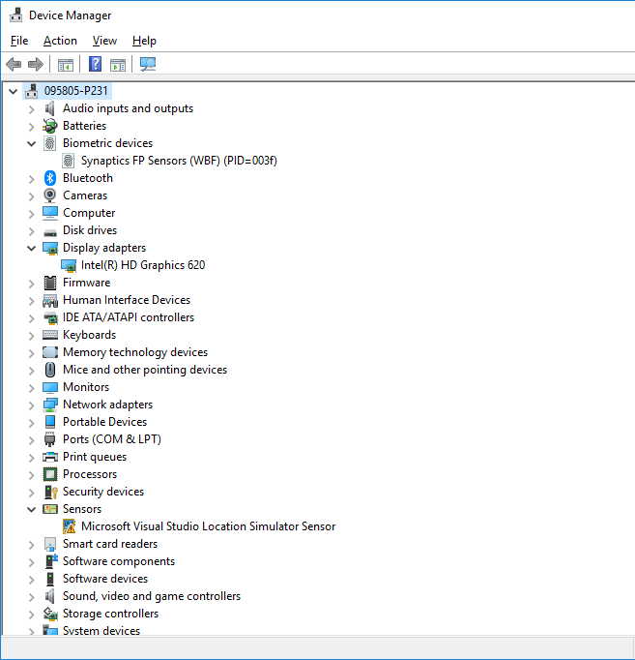

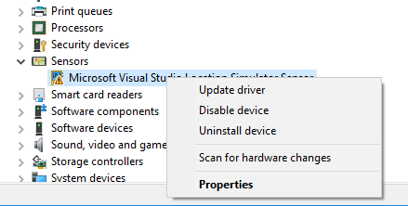
Device Manager: Undetected Device
Devices that are not detected, a driver need to be installed manually using the Update Driver.
Driver not detected for device.
Notice the warning sign.

Slide 17
Importance of Correct Computer Date & Time
Keeping the correct time on your computer is essential, especially when using it as a business computer.
The computer keeps its own date and time internally and uses it on files, documents, and reminders.
If the date and time are not set correctly, bad dates become a flood of erroneous information, leading to lost files, missed appointments and poor recordkeeping.
Network problem might occur:
Not able to join / access a network.
Not able to sync files on shared resource.

Slide 18
After OS Installation: Choosing a proper PC Name
The computer name is an important piece of information that will you as a support employee to identify this specific PC.
The computer name will be used in logs as an identifier.
Very useful when troubleshooting network problems.
What is a good name for a PC?
Personal PC (assigned to a specific person): use the user’s name with an identifier.
Example: User: Barry Allen – Works in the forensics lab, PC Name: BAllen-Lab
Public PC: used by a group user: use a name to identify the location.
Example: PC used to search the library book, PC Name: Library-search

Slide 19
Domain vs Workgroup
Workgroup (Default setting in Windows OS)
All computers are peers; no computer has control over another computer.
Each computer has a set of local user accounts. To log on to any computer in the workgroup, you must have an account on that computer.
Typically a workgroup has less than twenty computers.
A workgroup is not protected by a password.
All computers must be on the same local network to access the other computers.
Domain
Contains at least one server: used to control security and permissions for all computers on the domain.
A user domain account allows a user to log on to any computer on the domain without needing an account on that computer.
Domain users must provide a password or other credentials each time they access the domain.

Slide 20
User Profiles

Slide 21
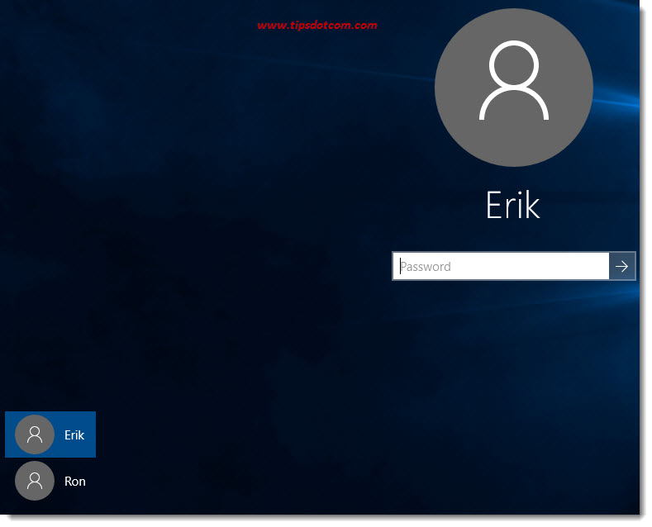
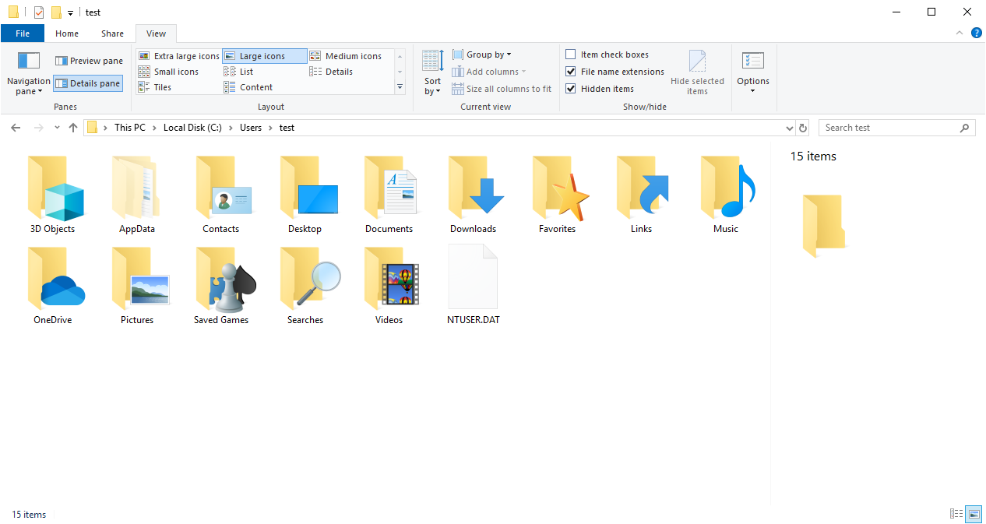
User Profiles
A user profile is created the first time a user logs into a computer.
During subsequent logins, the system loads the user's profile and configures the computer environment according to the information stored in the user profile.

Slide 22
Adding a Second User Profile
Start 🡪 Control Panel
User Accounts 🡪 Manage Other Account
Add a user account
Using Microsoft Account
Without a Microsoft Account

Slide 23
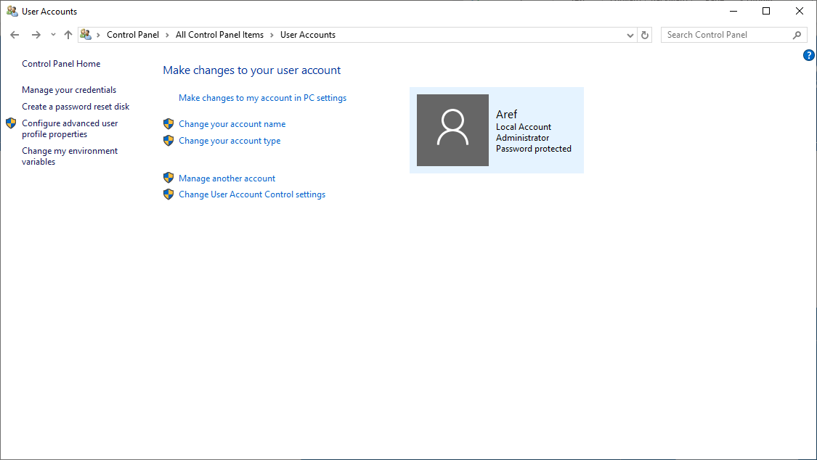
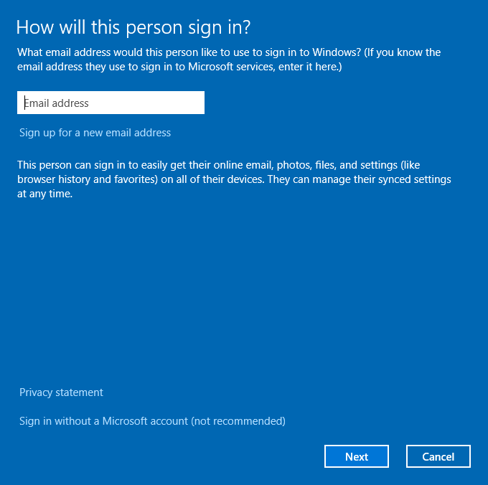
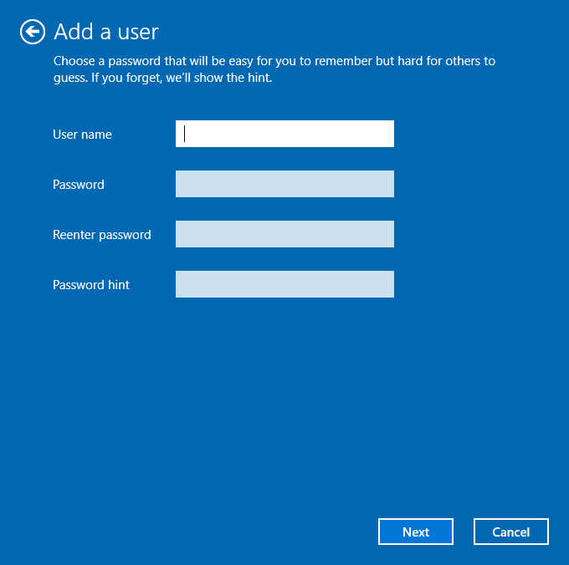
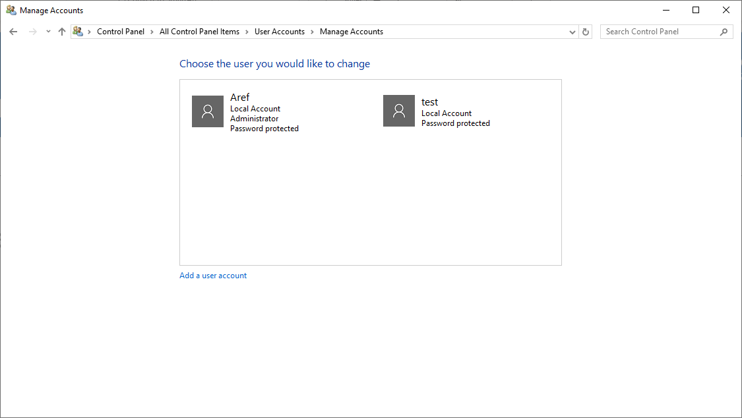
Adding a Second User Profile

Slide 24
Changing the Local Profile Language
Login to second account.
Type settings in the search area on the task bar and select Settings.
Select Time and language.
Select Region and Language from the left panel.
Click on Add language.
Add desired language from the given list (French Canada).
Click on the French language and click on Set as Default button.

Slide 25
Handling User Profiles
A user profile consists of the following:
Registry hive loaded by the system when the user logs in. HKEY_CURRENT_USER key stores user preferences and configuration.
A set of folders stored in the file system.
Containers for applications and other system components to populate with sub-folders and user-specific data such as documents and config files.

Slide 26
Types Of Profiles
Local Profile
A local user profile is created the first time a user logs onto a computer.
This is stored on the computer's hard drive.
Changes are specific to user and computer on which the changes are made.
Roaming Profile
A copy of the local profile that is copied to and stored on a shared server.
This is downloaded to any computer within the network that the user logs into.
Changes to a roaming profile are saved to the server when the user logs off.

Slide 27
Types Of Profiles (2)
Mandatory Profile
Administrators can create mandatory user profiles with settings for users.
These settings can only be changed by the administrator.
Any changes made to the profile by the user are lost once the user logs off.
Temporary Profile
A temporary profile is created if an error prevents user profile from loading.
These profiles are deleted automatically at the end of each session.
Any changes made to the profile by the user are lost once the user logs off.

Slide 28
Advantages Of User Profiles
When the user logs onto a computer, the system uses the same settings that were in use when the user last logged off.
When sharing a computer with other users, each user receives their own customized desktop after logging on.
Settings in the user profile are unique to each user and cannot be accessed by other users.
Changes made to one user's profile do not affect other users or their profiles.

Slide 29

Password Reset Disk
Can only be created for a local user account (only needs to be done once).
Requires a USB flash drive or SD Card (you cannot use CD or DVD).
Control Panel 🡪 User Accounts 🡪 Create a password reset disk.

Slide 30
Windows Registry

Slide 31
Windows Registry
Huge database that stores everything about the PC including information on all the hardware, network information, user preferences file types and practically everything you find in Windows.
Every version of Windows stores Registry files called hives in the \%SystemRoot%\System32\ config folder and each user account folder.
Computer technicians should:
Understand basic Registry components,
Know how to edit the Registry manually,
Know the best way to locate a particular setting.

Slide 32
Accessing Registry
To access the Registry, type “regedit” in the Start 🡪 Search bar (or Spotlight).
The Registry is organised in a tree structure similar to the folders in a file system.
It shows keys (or subkeys) on the left and values on the right.

Slide 33
Five main subgroups or root keys
HKEY_CLASSES_ROOT | Historically this root key defined the standard class objects used by Windows. Now this root key provides backwards compatibility for older applications.
HKEY_CURRENT_USER HKEY_USERS | These store personalized information for each user that has an account on the system such as desktop colours, screensavers and desktop contents.
HKEY_LOCAL_MACHINE | Contains all the data for a system’s non-user-specific configurations. This encompasses every device and every program in your computer.
HKEY_CURRENT_CONFIG | If the values in HKEY_LOCAL_MACHINE have more than one value, e.g. two different monitors, this root key defines which one is currently being used.

Slide 34
Using Registry Editor
When you use the Registry Editor to access the Registry, you risk breaking things.
Applications might not start, utilities may not work, or your computer may not boot.
Always make a backup of the Registry (preferably into a thumb drive) before you change anything. After you make the change, reboot the system to see if it had the desired effect. If not, restore the old Registry settings from your backup.

Slide 35
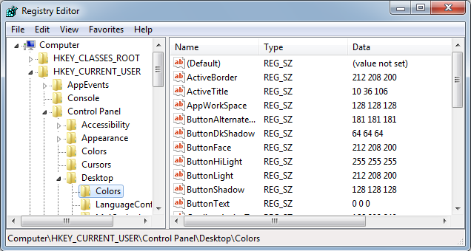
Using Registry Editor

Slide 36
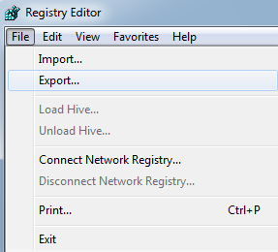
Using Registry Editor
To save a copy of the Registry,
Export the full registry or a single key or subkey (with all subkeys and values under it) using File → Export.
Saved with the extension .reg
To restore a set of backed up registry keys,
Use File → Import or right-click on the icon and select Merge.

Slide 37
OS Maintenance

Slide 38
Preventative Maintenance Tasks
Disk cleanup.
Disk defragmentation.
Hard drive error checking.
Updates to OS (e.g. service packs) and applications.
Updates to antivirus and other protective software.

Slide 39
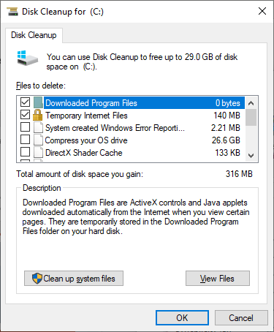
Disk Cleanup
Removes unneeded files e.g.
Temporary internet files
Files downloaded to install programs
Files in the recycle bin
Log files
Temporary files
Thumbnails
Admin can also clean up system files.

Slide 40
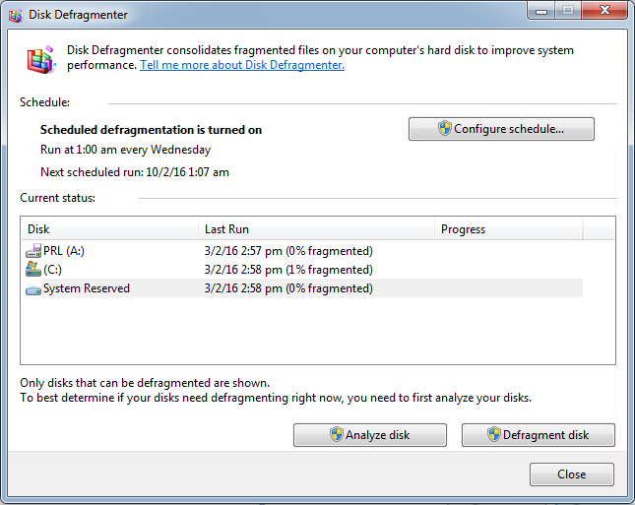
Disk Defragmentation
If a storage device is fragmented, it can slow down your computer.
A disk can become fragmented very quickly if it is used heavily and data is written to it often.
Disk defragmenter typically runs on a schedule but you can analyze and defrag manually.

Slide 41
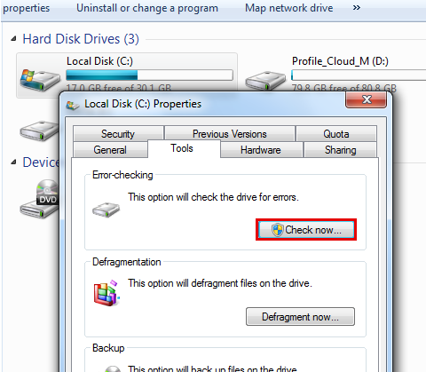
Hard Drive Error Checking
The Disk Check tool in Windows can find and repair file system errors on:
Local hard drives.
Removable media such as USB flash drives or memory cards.

Slide 42
Updates to OS and applications
A service pack is a collection of updates, fixes or enhancements to a software program, delivered in the form of a single installable package. They may introduce new features to an OS as well as bug fixes, security enhancements, etc.
It is common to have service packs issued within the first two years of release of a product, and they are usually numbered, e.g. SP1, SP2.
Note: Microsoft recommends that you never be more than two service packs behind.

Slide 43
Installing Service Packs
Use a change control process.
Read all related documentation.
Is the update necessary?
Test in a non-production environment.
Plan to uninstall.
Maintain consistency across servers.
Schedule downtime accordingly.
Always have a backout plan.
Advise support staff in advance.
Target non-critical servers first.

Slide 44
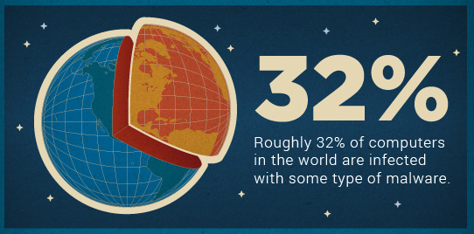

Updates to antivirus and other protective software
Antivirus software must be updated regularly to stay effective against new viruses.
This can be handled automatically by the software or manually by the user.

Slide 45
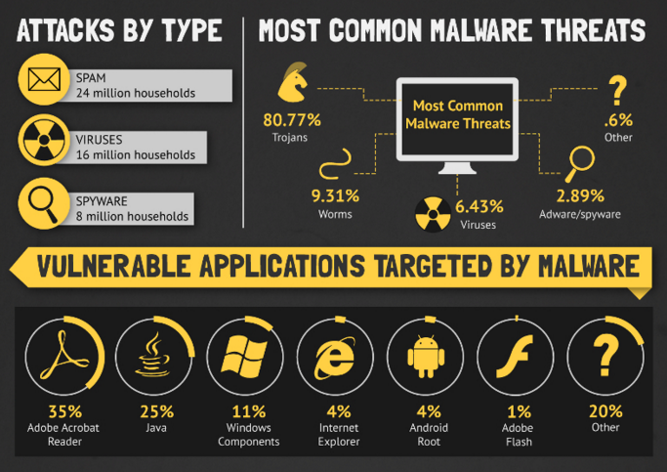

Slide 46
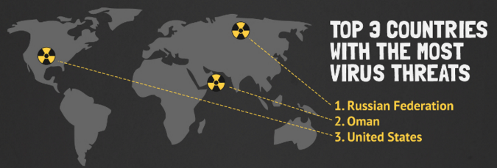
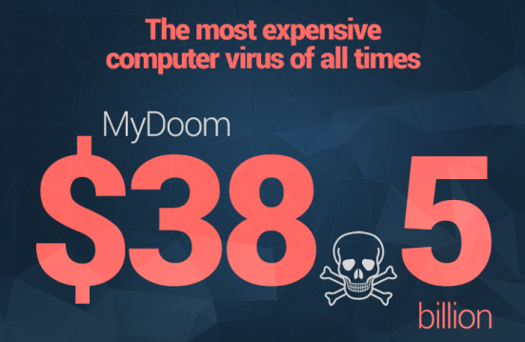
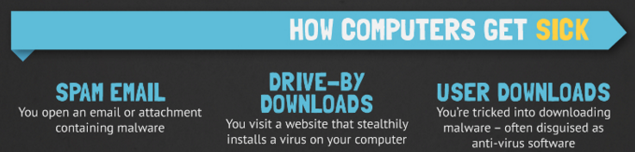

Slide 47


Slide 48
Q & A
Notes:
In Slide Show mode, click the arrow to enter the PowerPoint Getting Started Center.

